Slide 1
Collaborative Filtering
Arunabh Singh – W9D2 July 2020 Cohort

Slide 2
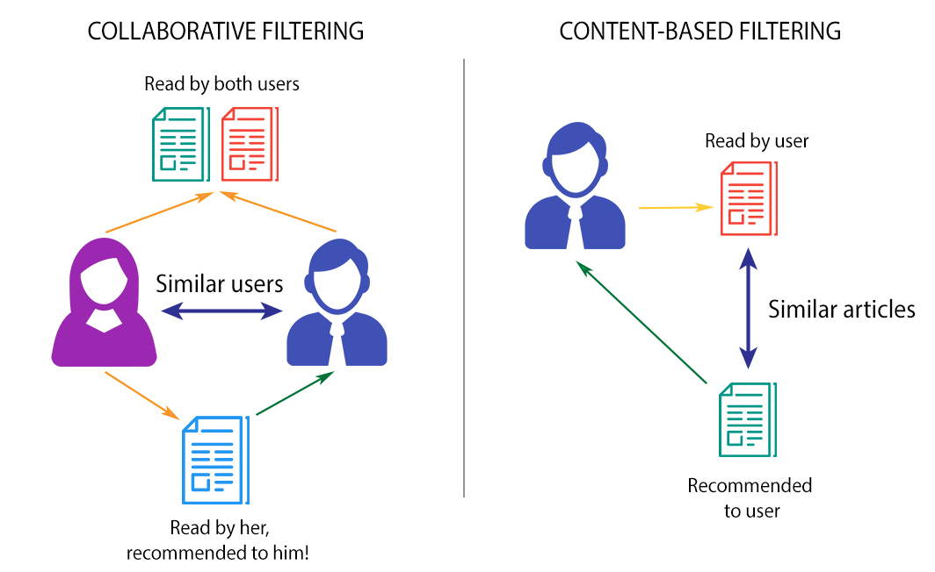
What Is Collaborative Filtering?#
Collaborative filtering is a technique that can filter out items that a user might like on the basis of reactions by similar users.
It works by searching a large group of people and finding a smaller set of users with tastes similar to a particular user. It looks at the items they like and combines them to create a ranked list of suggestions.

Slide 3
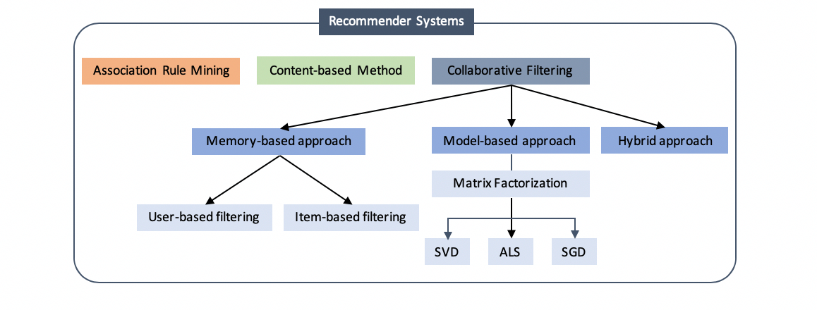
Types of Recommender Systems

Slide 4
Association Rule Mining Revision
First step is to generate an itemset like {Bread, Egg, Milk}
Second step is to generate a rule from each itemset like {Bread → Egg, Milk}, {Bread, Egg → Milk}
Frequent itemsets are the ones which occur at least a minimum number of times in the transactions.
Generate all frequent itemsets (support ≥ minsup) having only one item.
Next, generate itemsets of length 2 as all possible combinations of above itemsets.
Then, prune the ones for which support value fell below minsup.
Now generate itemsets of length 3 as all possible combinations of length 2 itemsets (that remained after pruning) and perform the same check on support value.

Slide 5
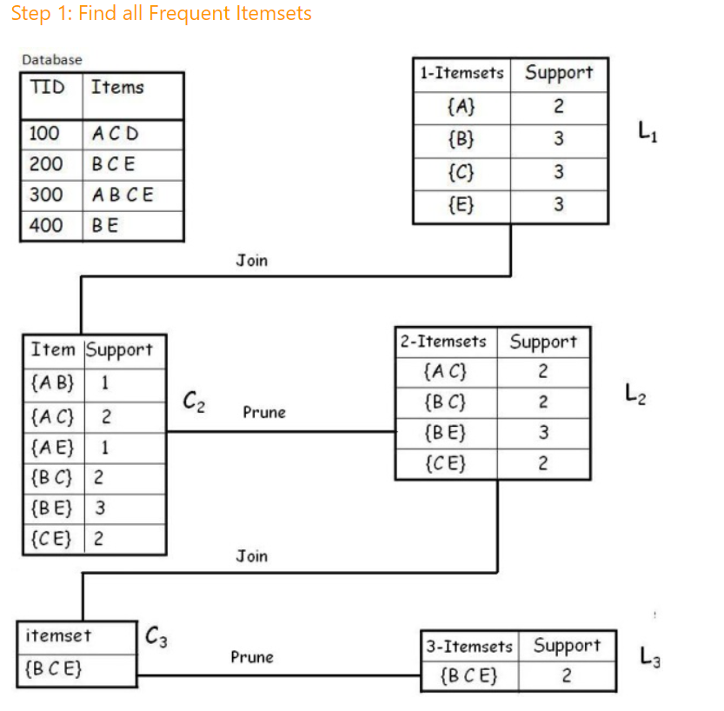
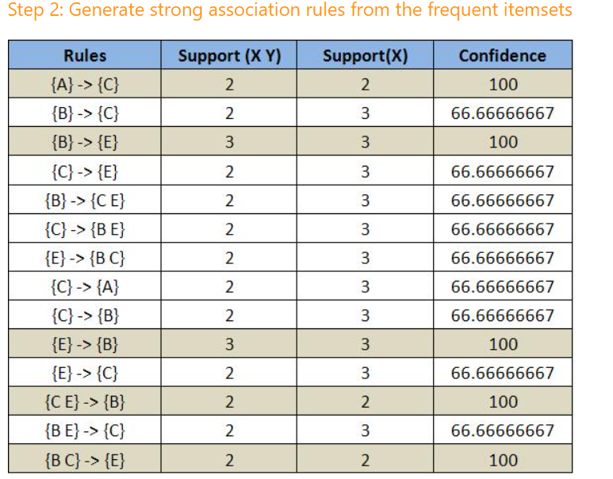
Steps to Perform Apriori

Slide 6
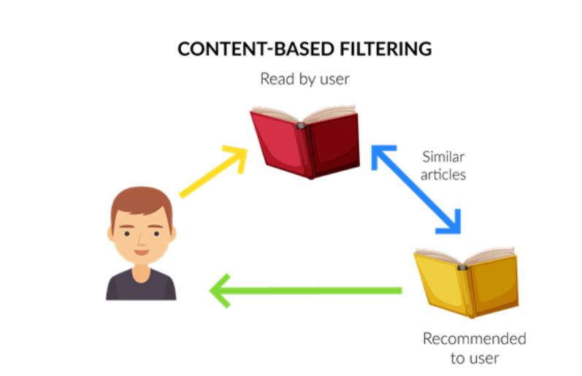
Content Based Recommendation Revision
If you read specific articles.
The representations of these articles as vectors will be similar to some other article representations as vectors.
A measure like cosine similarity is used to find similar articles.
These similar articles are then recommended to you if you haven’t read them to improve your engagement with the website or article medium.

Slide 7
Collaborative Filtering: Memory Based Approach
Memory-based collaborative filtering computes similarities between users or items and predicts a new rating for an item by taking the weighted average of ratings from the similar group.
There are two types in this approach: user-based filtering and item-based filtering.
For user-based filtering: “users who are similar to a certain user also liked…”
For item-based filtering: “users who preferred a certain item also liked…”
User-based filtering first selects a user and finds users who have similar rating patterns. The recommender system then can suggest items that those similar users liked.
Item-based filtering, on the other hand, takes an item first and finds users who liked the particular item, then searches other items that those users also liked.
Which one of the two is faster ?

Slide 8
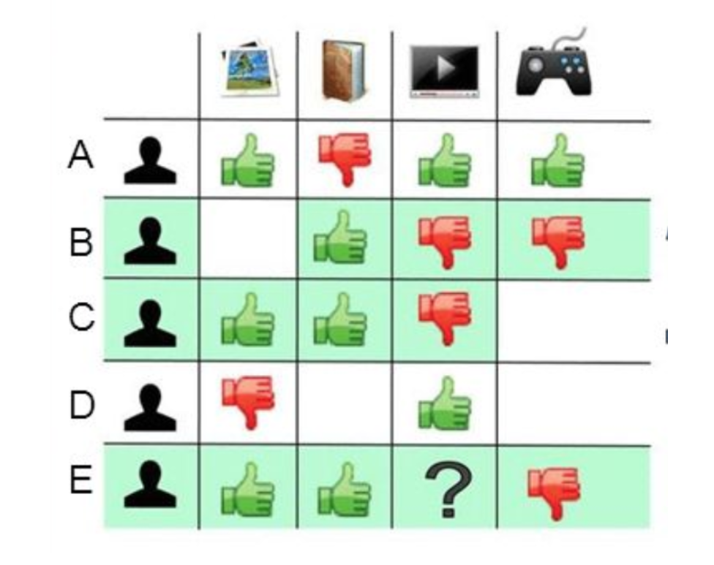
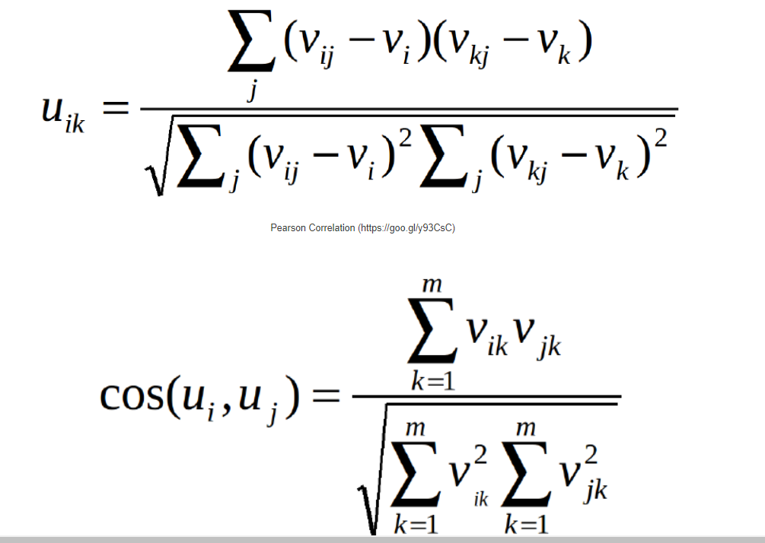
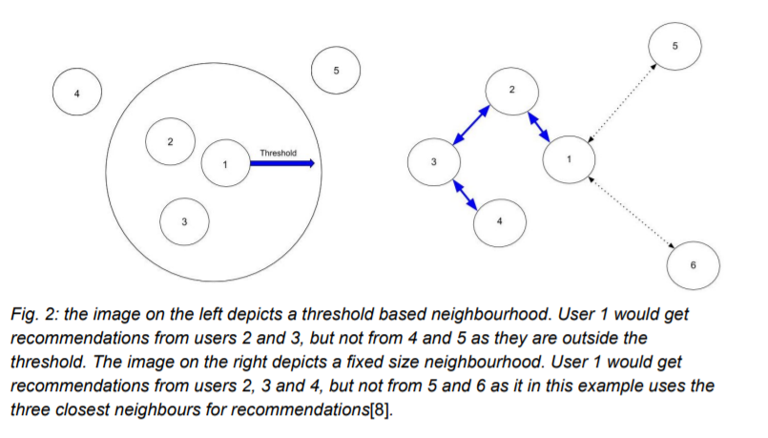
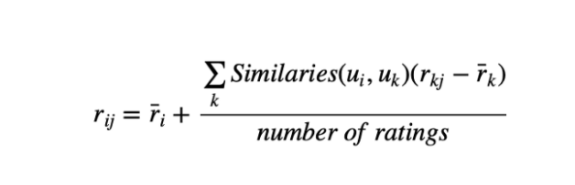
User-User Collaborative Filtering
Formula for User Similarity

Slide 9
User – User Collaborative Filtering
The process is to calculate the similarities between target user i and all other users, select the top X similar users, and take the weighted average of ratings from these X users with similarities as weights.
While different people may have different baselines when giving ratings, some people tend to give high scores generally, some are pretty strict even though they are satisfied with items. To avoid this bias, we can subtract each user’s average rating of all items when computing weighted average, and add it back for target user, shown as below.

Slide 10
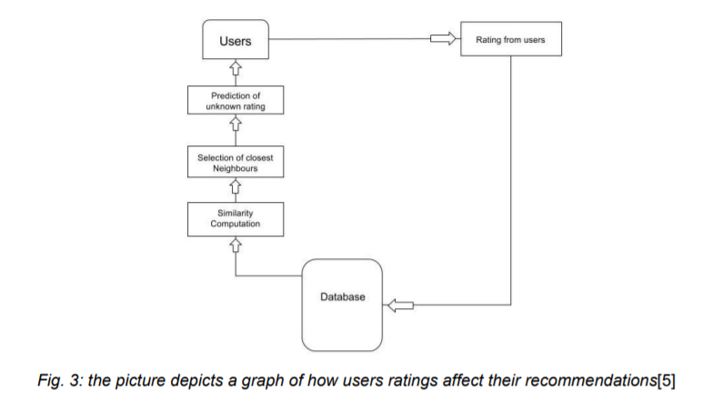
Item based collaborative filtering
Item based collaborative filtering was introduced 1998 by Amazon[6]. Unlike user based collaborative filtering, item based filtering looks at the similarity between different items, and does this by taking note of how many users that bought item X also bought item Y.
If the correlation is high enough, a similarity can be presumed to exist between the two items, and they can be assumed to be similar to one another.
This item can then be recommended to a user

Slide 11
Model Based Collaborative Filtering

Slide 12
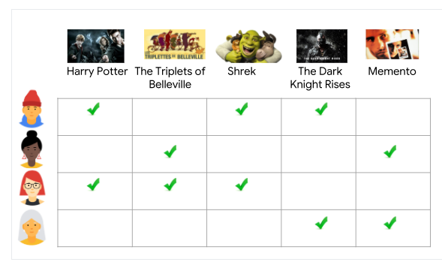
How our data looks like
Can we use this half filled matrix to get unfilled ratings for each user ? Let’s see how ML can help

Slide 13
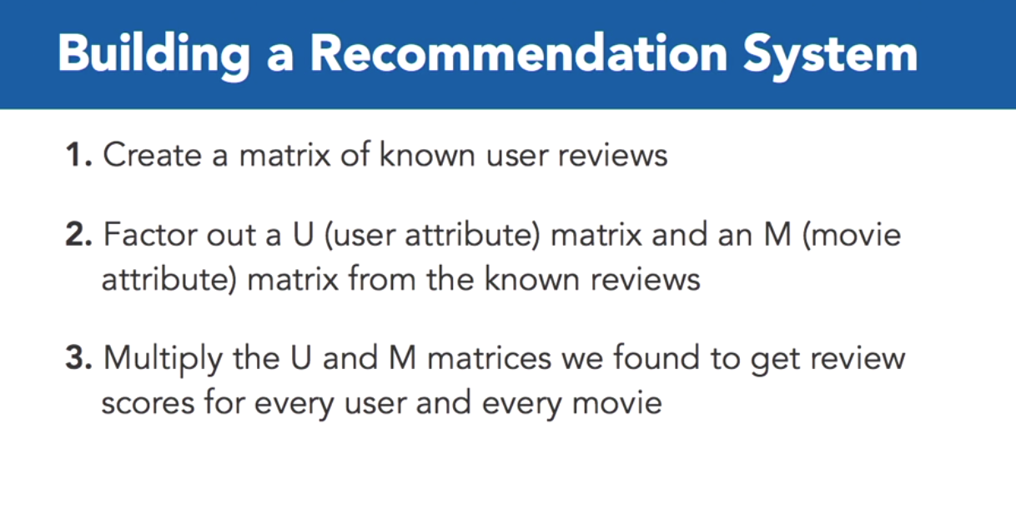
Model Based Collaborative Filtering

Slide 14
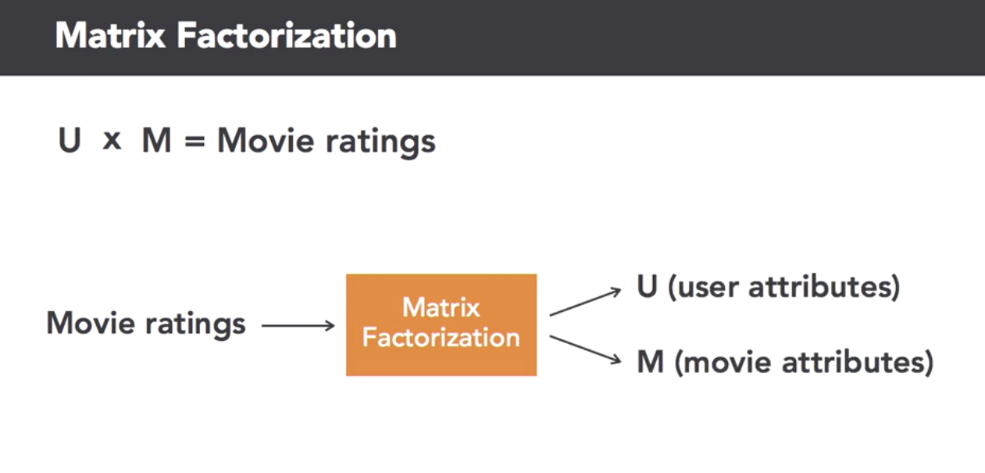
Matrix Factorization helps us reduce Movie Ratings Matrix into Movies and Users Matrix.
These Matrices will be dense representations of the Movie Ratings Matrix.

Slide 15
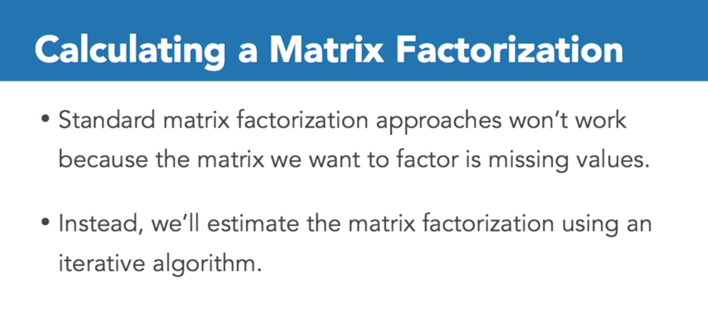
Ideally a large filled matrix can be easily decomposed.
However, since we have missing values since no user rates all movies.
Hence our matrix has a lot of missing values. Thus we will use an iterative algorithm to do this.

Slide 16
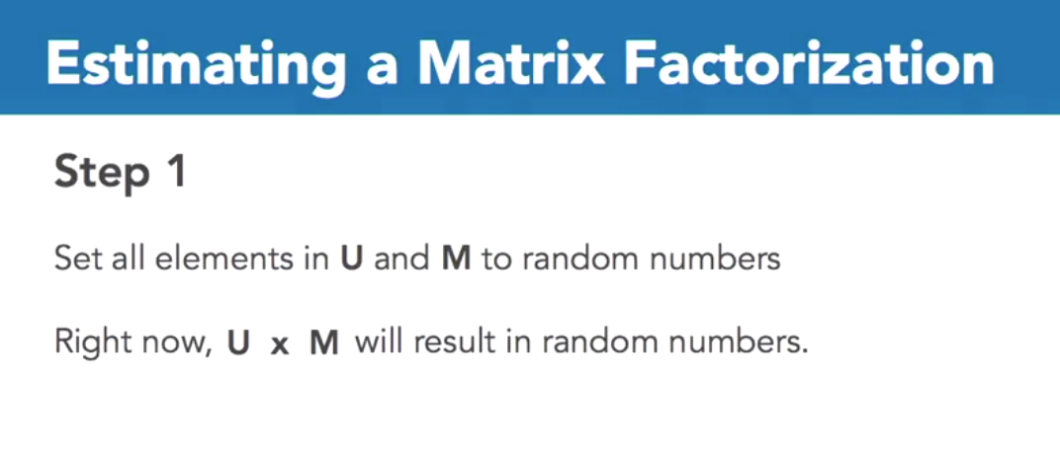
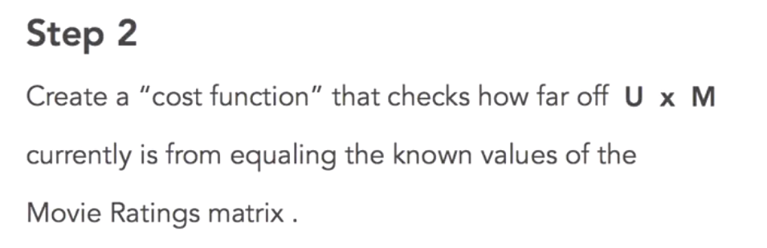

Slide 17
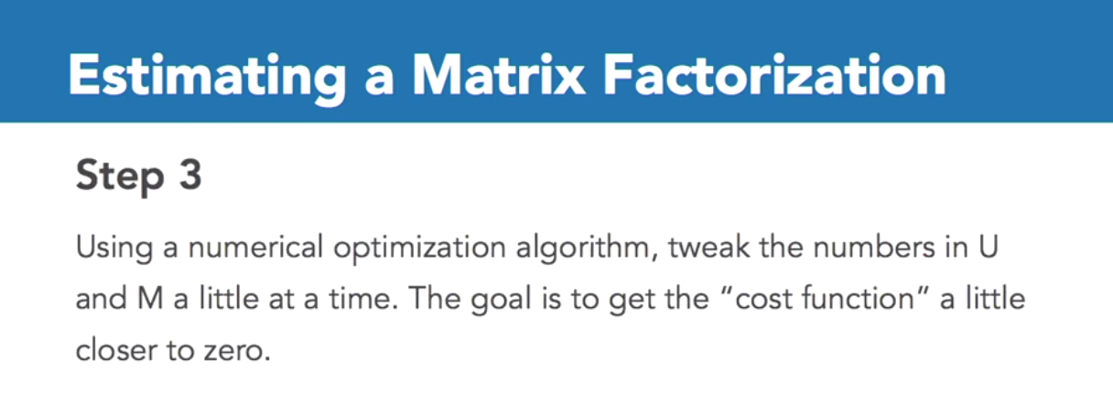
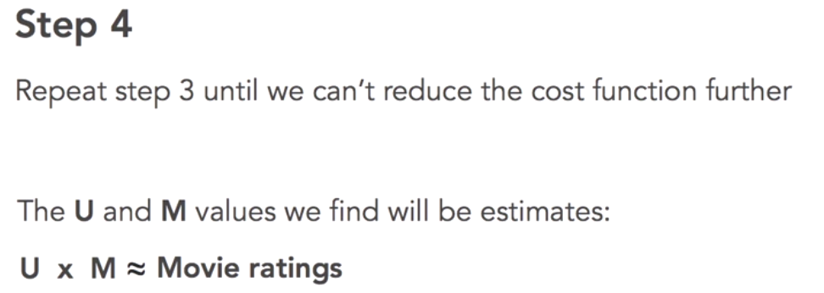

Slide 18
Summary of Model Based Collaborative Filtering Technique

Slide 19
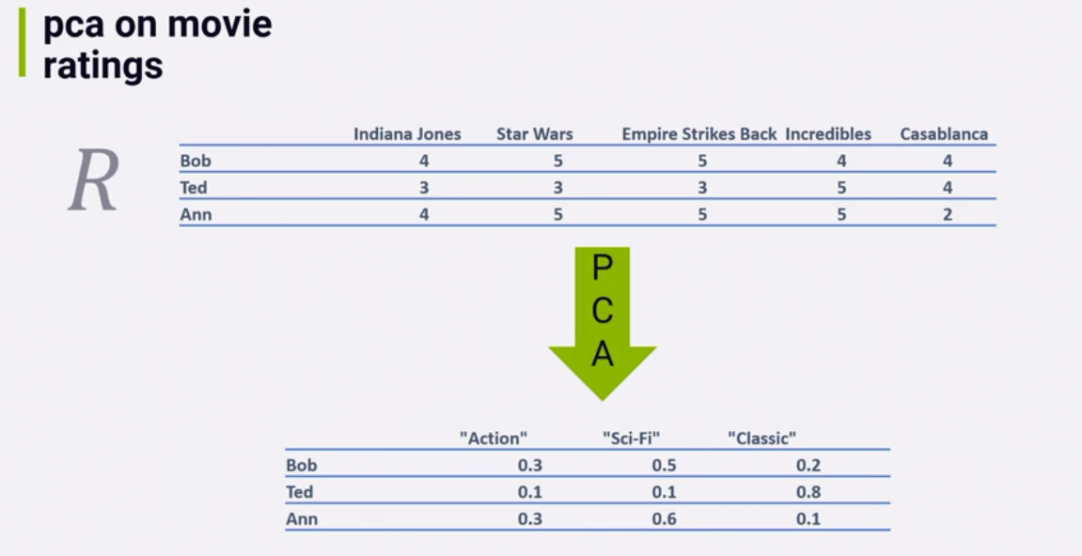
Example matrix decomposition - PCA

Slide 20
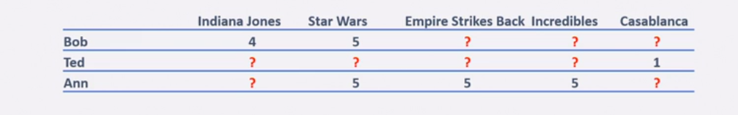
But we cant use PCA because of….
Missing values means matrix decomposition cannot happen naturally.
We thus use Machine Learning iterative approach to complete the missing values.
The filled values which are ratings for users if high, those movies can be recommended to a user.

Slide 21
Is this really SVD ?
This is not SVD in reality.
Actual SVD works on filled data in matrices like PCA does.
This SVD is basically an algorithm inspired from SVD.
Trivia: The algorithm used in Netflix Prize data was a variant of SVD known as SVD++ and also used Restricted Boltzmann Machines.
Other variants of SVD include Truncated SVD and Funk SVD.

Slide 22
Cold Start Problem
New user has no ratings and cant be recommended anything. This is known as a cold start problem.
We can recommend top recommendations to him.
We can use content based filtering to recommend him movies.

Slide 23
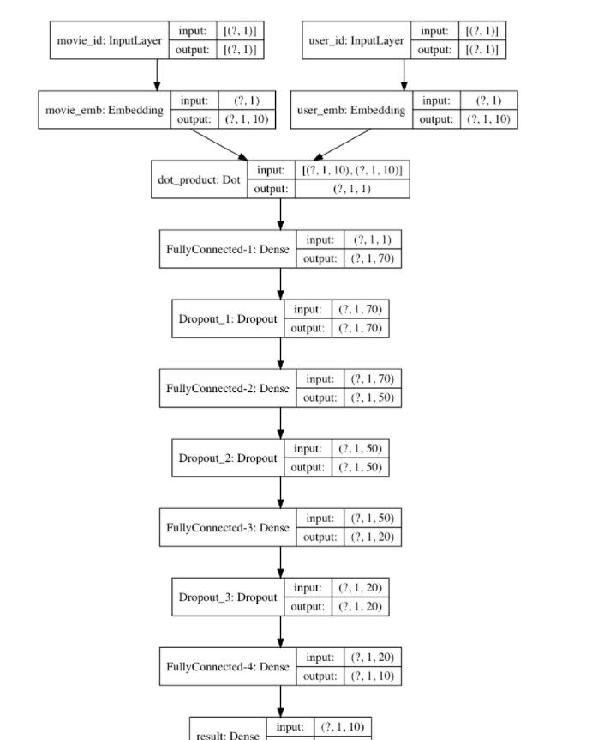
Using NN for Recommender Systems

